Slide 1
Automatic Evaluation of la in SyreDesign
Nov 3, 2015

Slide 2
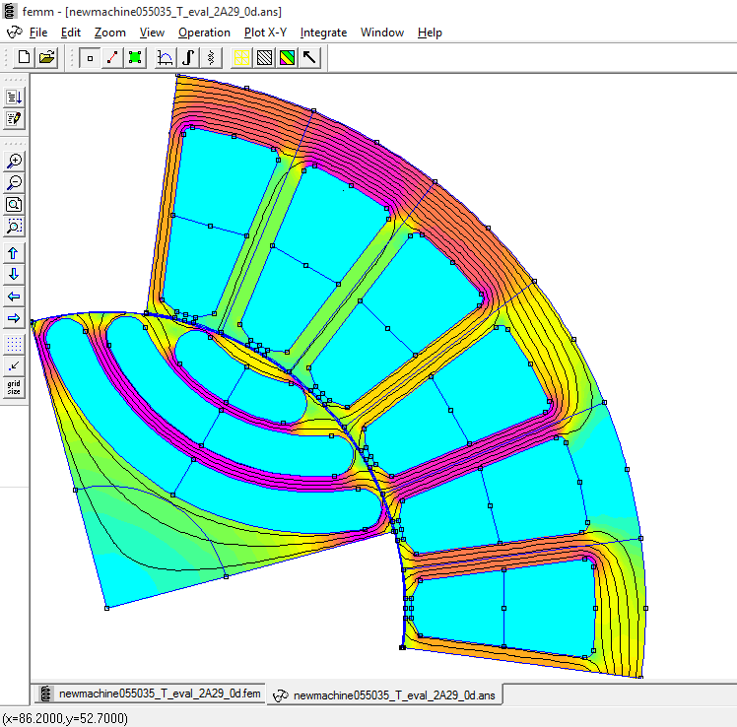
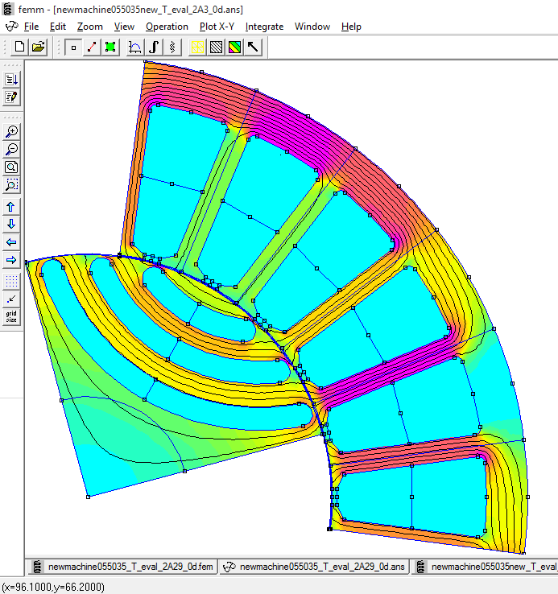
Background
la0. Simple formula (boot camp 2014) does not account for non uniform distribution of flux density at the airgap. All radial space (r – s) is weighted the same. Total carrier space ly is taken from r - s
la0 = r – s – ly
Result: la is too big, steel saturates heavily
la1. Second simple formula. Radial space corresponding to p*alpha1 elt degs is not accounted for. Total radial space is reduced to x0 – rbeta – s, and ly is taken from there
la1 = x0 – rbeta - s – ly
Result: la is too small. Steel is poorly loaded.

Slide 3
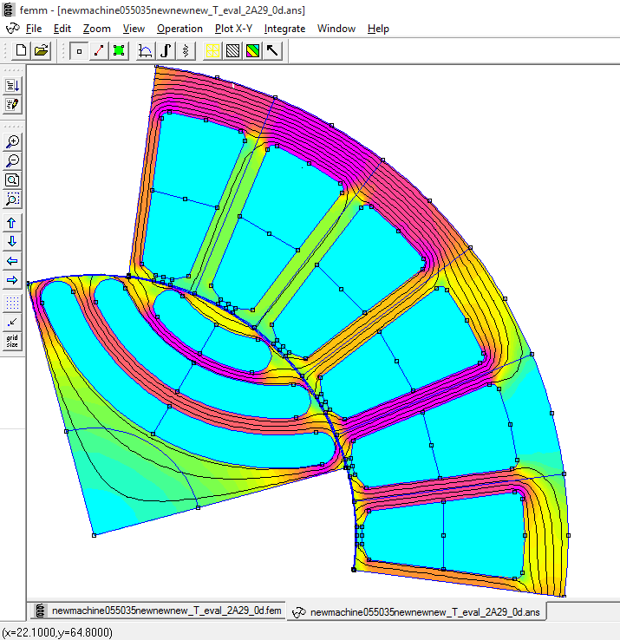
New Formula, Nov 2015
Nov 2014
la. Under assumptions of sinusoidal airgap flux density distribution and even hc radial space corresponding to (p*alpha1) elt degs accounts for a portion of half pole flux that is 1 – cos(p*alpha1), and this flows in nlay – ½ carriers (-1/2 accounts for the half-size spider). Reduced radial space x0 – rbeta – s contains the remaining portion of pole flux, worth cos(p*alpha1). Therefore a portion of ly equal to ly*cos(p*alpha1) is taken from there
la’ = x0 – rbeta - s – ly*cos(p*alpha1) (accounts for nlay-1/2 barrier widths)
Finally, the missing half of the top barrier is added (even hc):
la = la’ * nlay/(nlay-1/2)
Result: la is fairly estimated, peak steel loading is close stator steel one.
Nov 2015

Slide 4
Effect on reluctance factor kdq
Continuous line: la according to Nov 2015
Dotted line: la0 (boot camp 2014)
Result: kdq was overestimated by 0.5 to 1%
b
x

Slide 5
FEA Validation

Slide 6
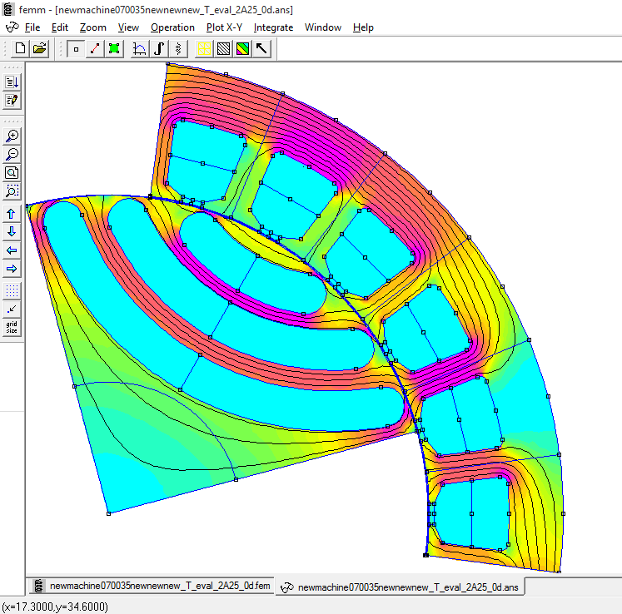
x = 0.55, b = 0.35, Nov 2015
x = 0.70, b = 0.35, Nov 2015

Slide 7
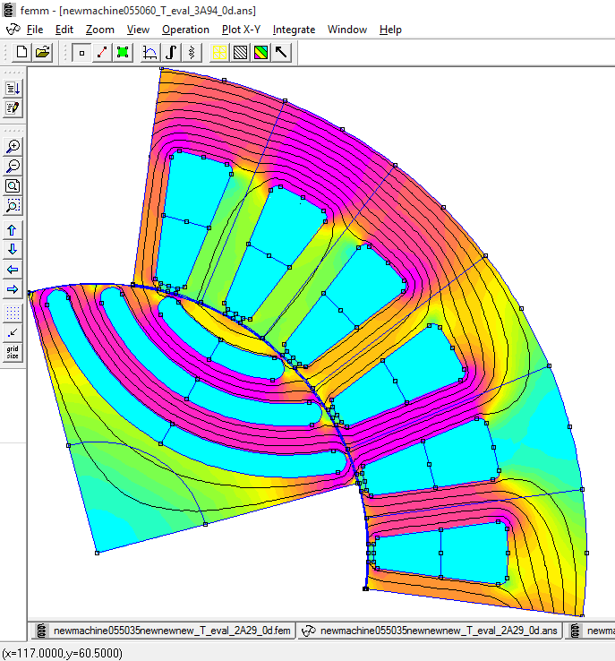
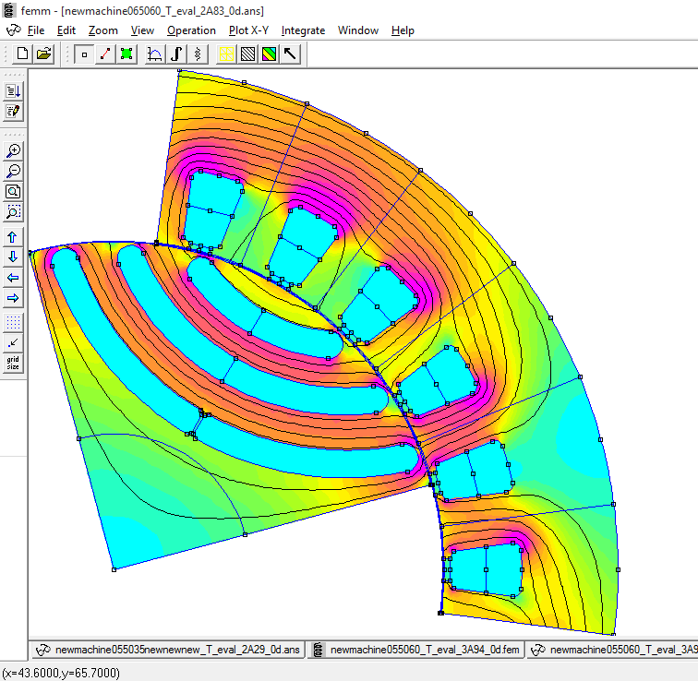
x = 0.55, b = 0.60, Nov 2015
x = 0.65, b = 0.60, Nov 2015

Slide 8
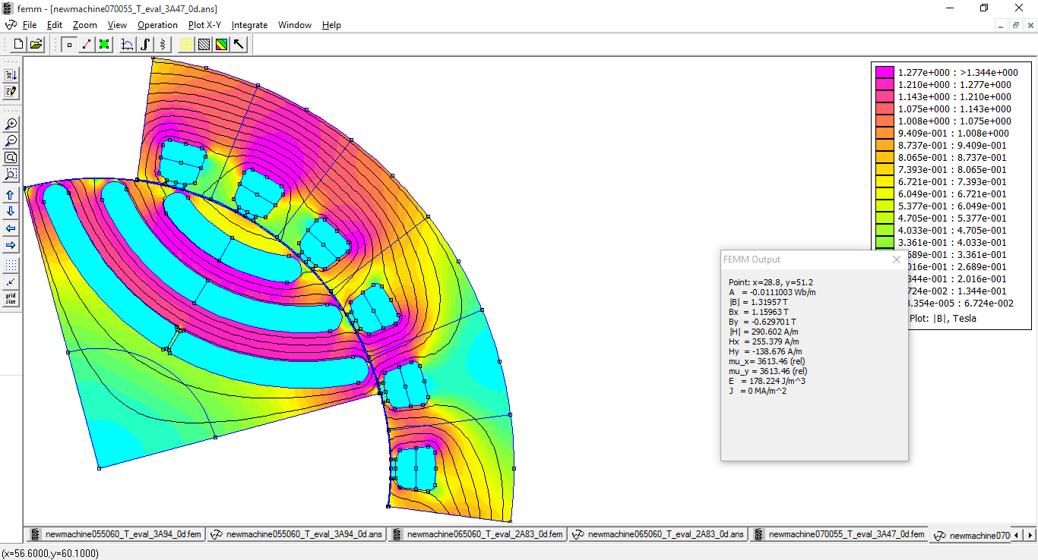
x = 0.70, b = 0.55, Nov 2015

